Slide 1

Non-specific binding

Slide 2
Non-specific binding and biosensing

Slide 3
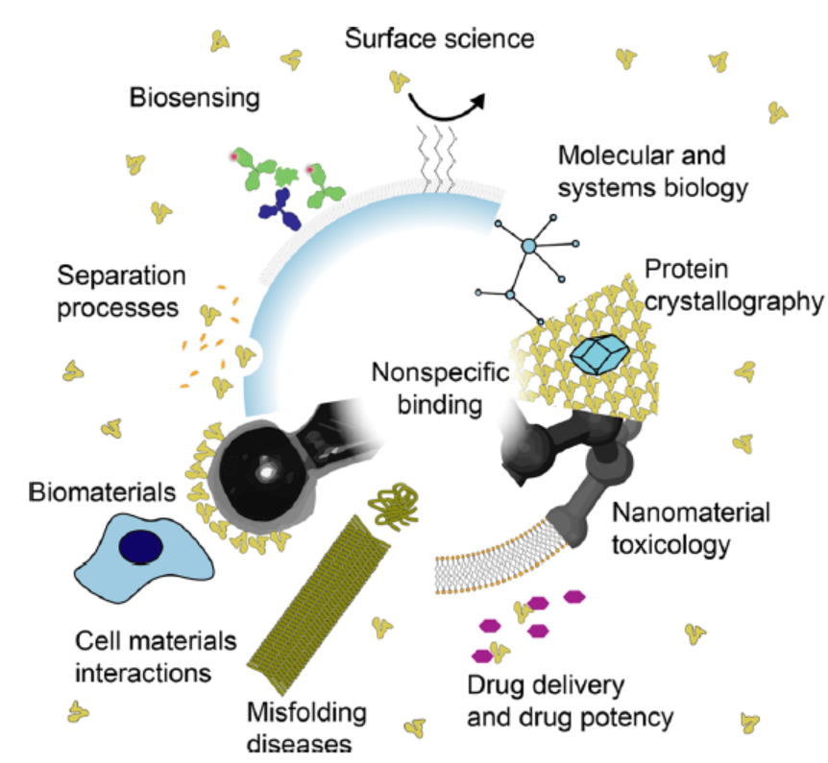
Definitions
Non-specific binding (NSB): binding to other biomolecules, particles, or surfaces that does not elicit the desired response of the biological or artificial system
Specific binding (SB) represents a molecule that interacts with its partner via a defined end state with sterospecificity and shape complementarity.
NSB is a molecule with an ill-defined binding interfaces where two molecules can interact in multiple ways without sterospecificity and shape complementarity.
In addition to playing a key role in biosensing, NSB influences the response of our body to foreign biomaterials such as drug delivery particles or surfaces of blood-contacting devices
Chem. Rev. 2021, 121, 8095−8160
Notes:
NSB can be devided into reversible and non reversible
Fields of study in which nonspecific binding (NSB) has major
implications. In surface science, the development of nonfouling
coatings emerged with the goal of minimizing NSB. In separation
processes, nonspecific interactions based on the size or charge are used
to separate different biomolecules. For biosensing, NSB is the main
limiting factor of state-of-the-art molecular diagnostic sensors. In
systems biology, NSB shapes the form of protein interaction networks
and in protein crystallography, nonspecific contacts between individual
proteins are responsible for the formation of protein crystals. Regarding
nanomaterial toxicology, NSB to nanomaterials can effectively reduce
their toxicity and determines their biodistribution. Simultaneously, in
drug delivery, NSB of drugs to plasma proteins reduces their effective
concentration and opsonization (the NSB to drug carriers) affects their
half-life in biological systems. In biomaterials research, NSB determines
the cellular and physiological responses to foreign materialsi.e.
implants. In medicine, NSB is important in the prevention and
nucleation of protein misfolding diseases.

Slide 4
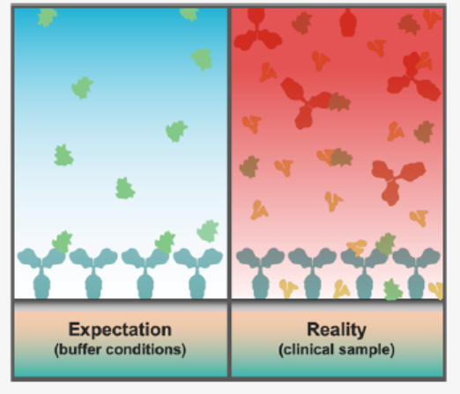
Why is NSB a problem in biosensing
The concentration of the interfering species is much larger than the target species
Antibodies of healthy people bind to 28% of all human proteins
If the affinity of the non-specific binder is 10 times weaker but the concentration is 10 times higher, the chance of binding is the same due to the thermodynamic equilibrium
In biosenising, the NSB of interfering molecules at the surface masks the signals from the analyte of interest available at much lower concentrations
NSB reduces the effective target concentration in the bulk
NSB blocks the receptor sites for target binding
NSB causes a false positive signal when it is captured on the receptor or on the transducer surface
Chem. Rev. 2021, 121, 8095−8160
Notes:
Historically it was believed NSB was Non-displacable and non-saturble or in other words non-Langmuir, later it was found that they appeared non-saturable because they were operated at low concentrations.
NSB multiple interaction sites on one protein versus well-defined interaction sites for specific interactions
Traditional definition of NSB as per the insulin radio immunoassay literature: binding of the ligand to all components of the surface with much lower affinity ≤ 100 folds) than the specific binders of interest.
Difficult to define NSB based on a specific affinity threshold as specific binding spans from fM (cell destruction protein binding) to mM (irreversible cell-cell adhesion)

Slide 5
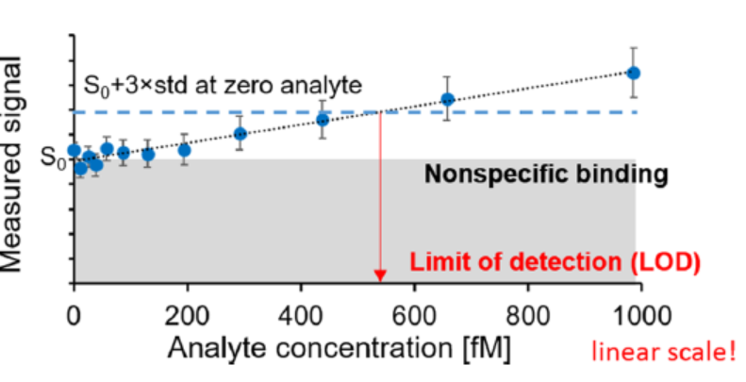
How does NSB affect the biosensing performance
Limit of detection is the concentration at which the signal equals the limit-of-blank
Limit-of-blank=S₀+stdv of S₀
Sensitivity=TP/(TP+FN)
Specificity=TN/(TN+FP)
TP: true positive, TN: true negative, FP: false positive, FN: false negative
Chem. Rev. 2021, 121, 8095−8160

Slide 6
Non-specific binding modeling

Slide 7
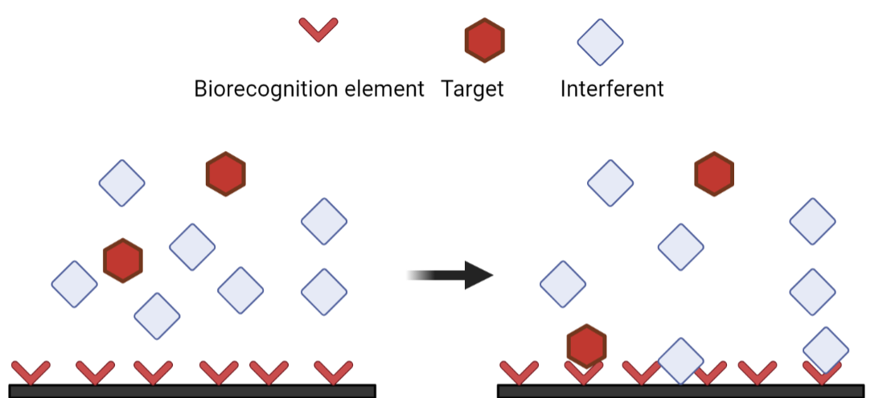
How to set up a model NSB?
NSB can occur from binding to a non-binding site region of the receptor and/or binding to “empty” spaces on the transducer surface
“Empty” spaces refer to the locations on the transducer surface that are not modified with biorecognition elements
Analytes interact with the biosensor surface through a solid liquid interface composed of the receptor and the surface
To maximize assay performance the receptor target system should have maximal specificity while the nonspecific background sites and the surface should be low fouling

Slide 8
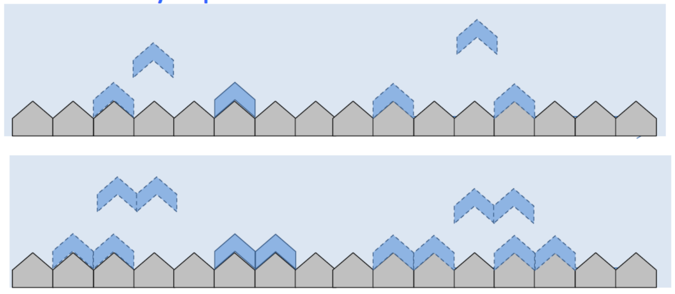
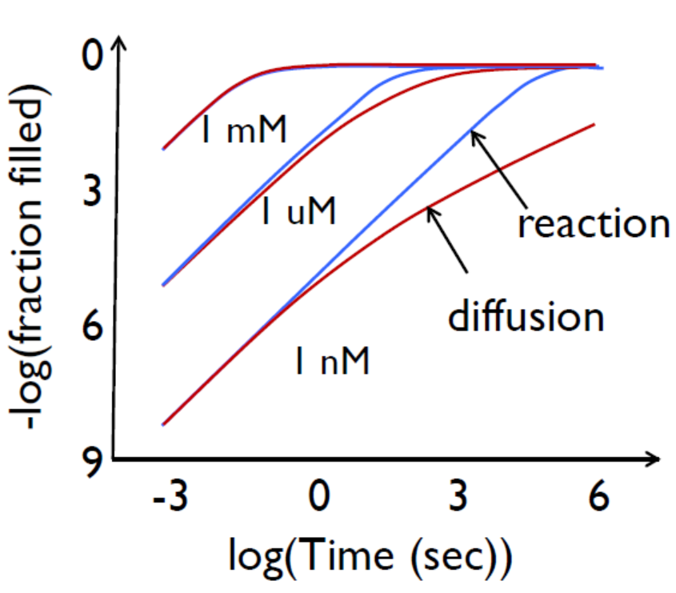
Why do we have empty spaces?
We assume the binding of the bio-recognition elements to the surface is irreversible
We can use the random sequential model to describe the immobilization of the biorecognition elements
For a two-dimensional surface, this model predicts that at most 54% of the surface gets immobilized even after reaching equilibrium
Image from Alam, Principles of Nanobiosensors, 2013

Slide 9
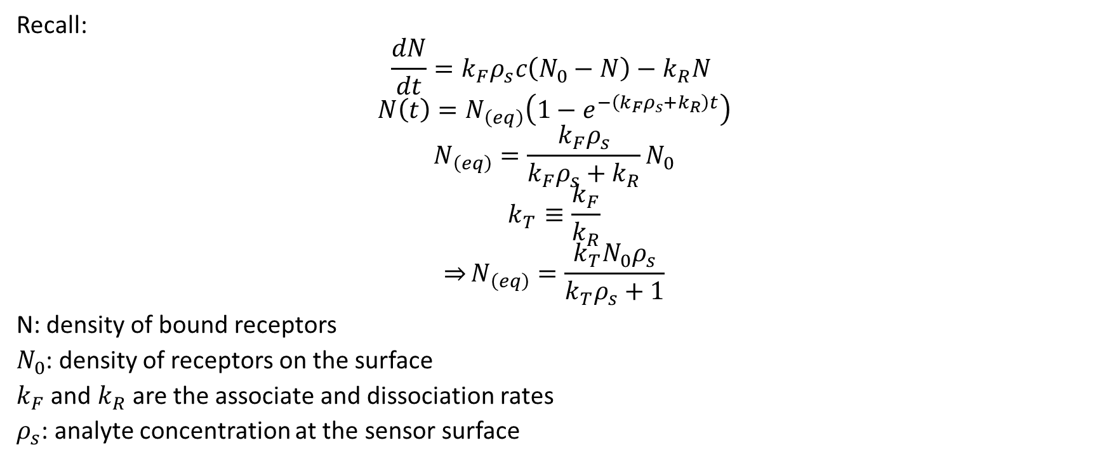
Recall the binding theory on surfaces
Recall:
$$\frac{dN}{dt}=k_{F}ρ_{s}c\left(N_{0}−N\right)−k_{R}N$$
$$N\left(t\right)=N_{\left(eq\right)}\left(1−e^{−\left(k_{F}ρ_{s}+k_{R}\right)t}\right)$$
$$N_{\left(eq\right)}=\frac{k_{F}ρ_{s}}{k_{F}ρ_{s}+k_{R}}N_{0}$$
$$k_{T}≡\frac{k_{F}}{k_{R}}$$
$${\overset{⇒}{}N}_{\left(eq\right)}=\frac{k_{T}N_{0}ρ_{s}}{k_{T}ρ_{s}+1}$$
N: density of bound receptors
$N_{0}$: density of receptors on the surface
$k_{F}$ and $k_{R}$ are the associate and dissociation rates
$ρ_{s}$: analyte concentration at the sensor surface

Slide 10
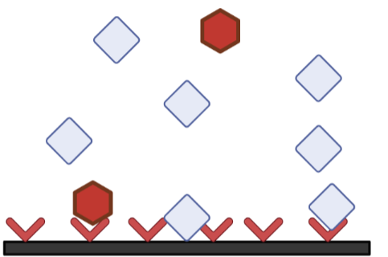
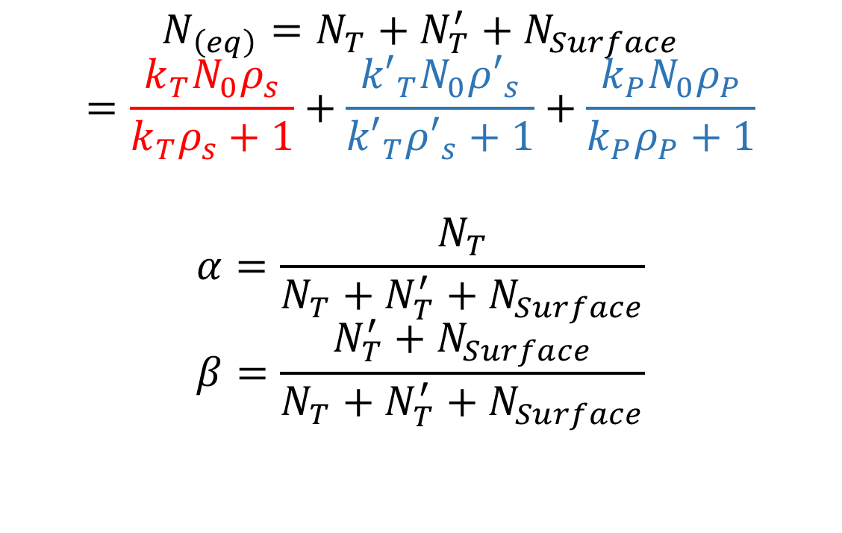
One NSB model (2)
$$N_{\left(eq\right)}=N_{T}+N_{T}^{′}+N_{Surface}$$
$$=\frac{k_{T}N_{0}ρ_{s}}{k_{T}ρ_{s}+1}+\frac{{k′}_{T}N_{0}{ρ′}_{s}}{{k′}_{T}{ρ′}_{s}+1}+\frac{k_{P}N_{0}ρ_{P}}{k_{P}ρ_{P}+1}$$
$$α=\frac{N_{T}}{N_{T}+N_{T}^{′}+N_{Surface}}$$
$$β=\frac{N_{T}^{′}+N_{Surface}}{N_{T}+N_{T}^{′}+N_{Surface}}$$

Slide 11
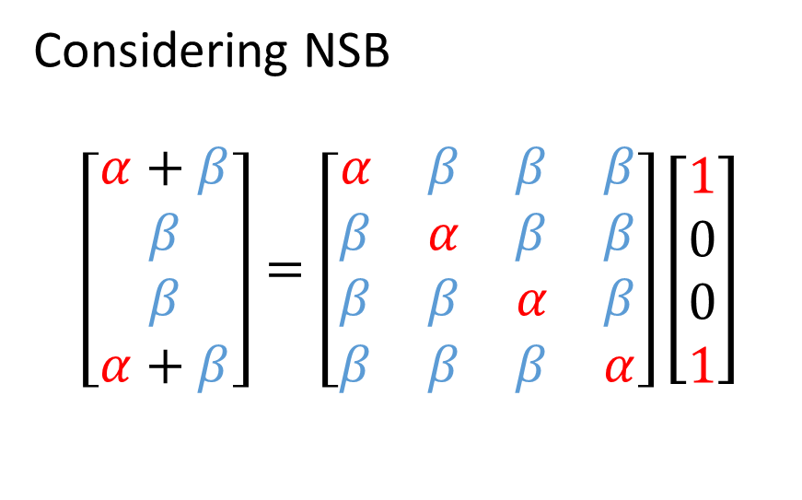
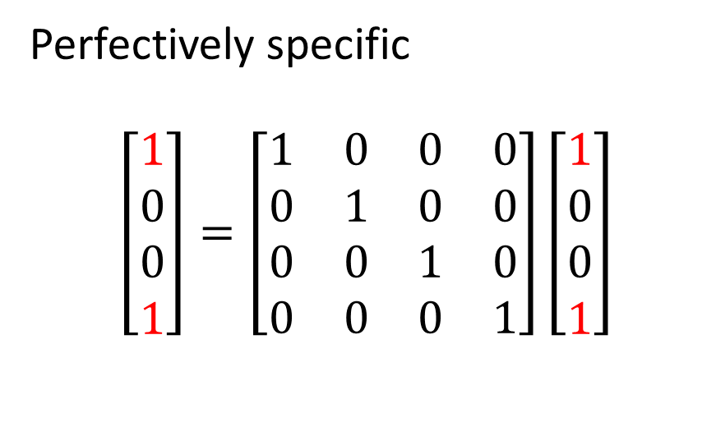
Responses to SB and NSB-matrix approach
Assume we have a four element biosensor that 2
Two elements capture the target
How can we estimate the sensor response?
Perfectively specific
$$\left[\begin{matrix}1 \\ 0 \\ 0 \\ 1\end{matrix}\right]=\left[\begin{matrix}1 & 0 & 0 & 0 \\ 0 & 1 & 0 & 0 \\ 0 & 0 & 1 & 0 \\ 0 & 0 & 0 & 1\end{matrix}\right]\left[\begin{matrix}1 \\ 0 \\ 0 \\ 1\end{matrix}\right]$$
Considering NSB
$$\left[\begin{matrix}α+β \\ β \\ β \\ α+β\end{matrix}\right]=\left[\begin{matrix}α & β & β & β \\ β & α & β & β \\ β & β & α & β \\ β & β & β & α\end{matrix}\right]\left[\begin{matrix}1 \\ 0 \\ 0 \\ 1\end{matrix}\right]$$

